Slide 1
Aramco Upstream Solutions Technathon 2019 AI challenge 2 Oilfield Geochemistry Analysis
Leyla Ismailova
Aramco Moscow Global Research Center

Slide 2
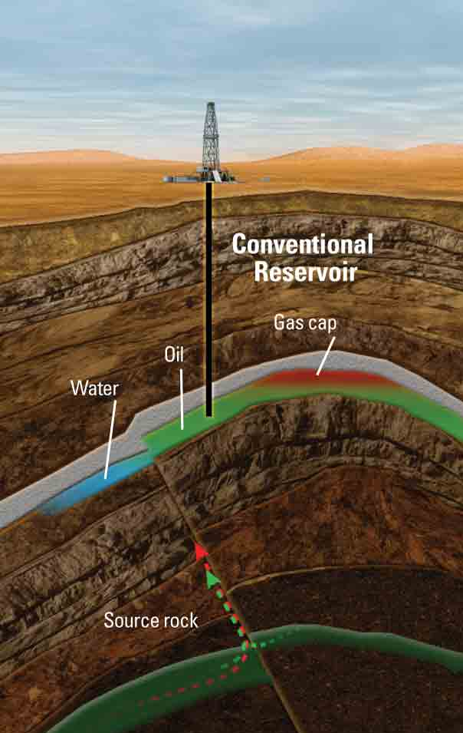
Motivation
Geochemistry is used in Exploration and Production
Geochemistry is used in finding, evaluating and producing petroleum deposits
Rocks
Geochemistry
Crude oils
Natural gases
Understanding of variations in hydrocarbon composition being produced can hep to anticipate significant production changes avoid losses
Geochemical historical analysis insures that production in the field is being done efficiently, and the recovery of hydrocarbons
is maximized increase revenue

Slide 3
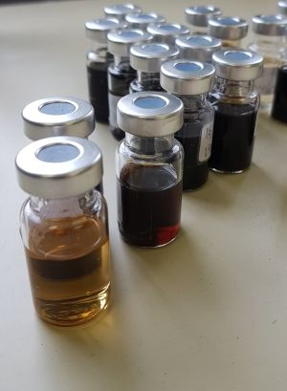
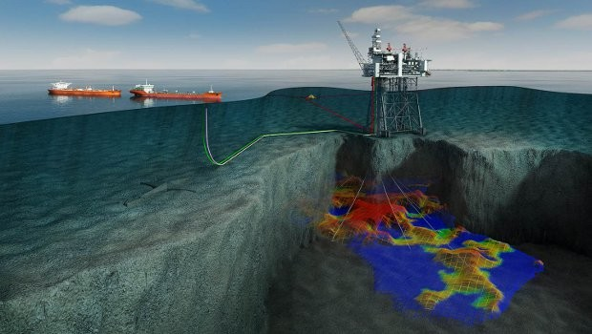
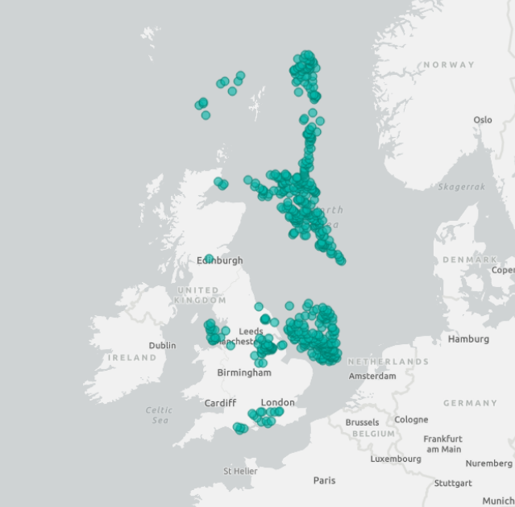

Slide 4

Dataset
CSV files with oil, gas, sample data with laboratory measurements, type of fluid or rocks, coordinates, sampling date
CSV file Production data

Slide 5

Details of the challenge
Predict geochemical properties in the region between wells based on production data
Perform feature engineering development to detect novelties and/or anomalies in geochemistry-production data
Predict and correlate time lapse geochemical data variation with production and block or field
Create XYZ (longitude, latitude, depth) maps and visualize time lapse prediction by focusing on the regions with data anomalies

Slide 6

Evaluation of the performance
A presentation with the data science solution to
1. Predict geochemical properties and will be checked against unreleased data.
2. Analyze which of geochemistry properties significantly impacts the production
3. Detect geochemical anomalies
4. Predict time-lapse behavior in geochemical and production data
5. Create a tool to plot geochemical maps and visualize time-lapse behavior and anomalies

Slide 7
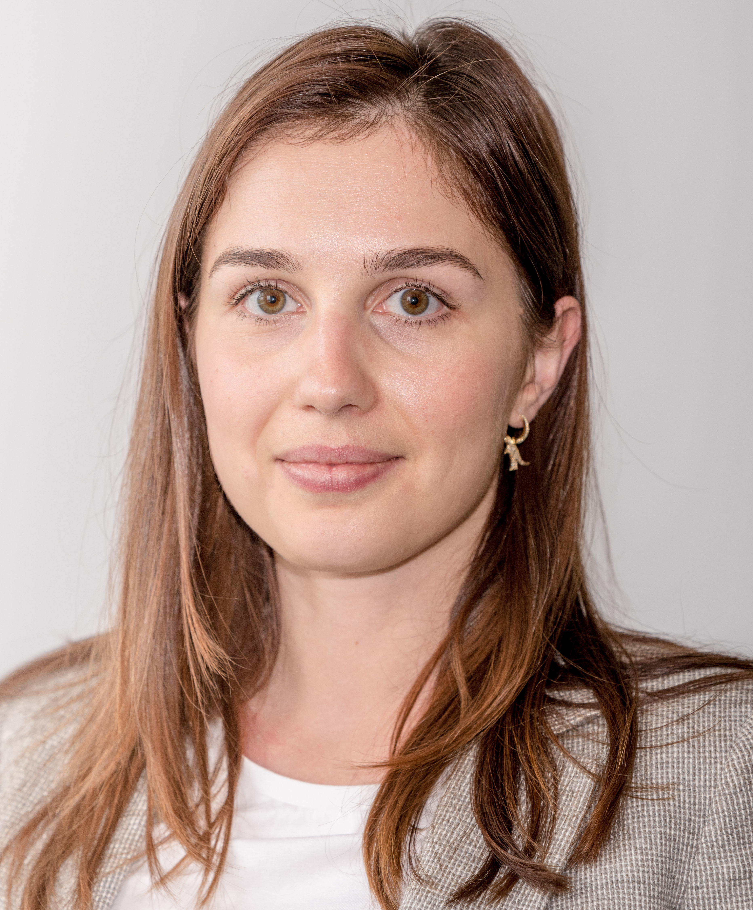

Subject matter experts
Leyla Ismailova Aramco Moscow Global Research Center
Email Leyla.Ismailova@aramcoinnovations.com
Sergey Safonov Aramco Moscow Global Research Center
Email: sergey.safonov@aramcoinnovations.com Phone: +7 906 0541631
https://github.com/aramcoinnovations/technathon2019.git

